Slide 1
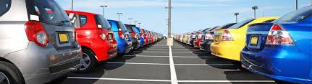
Car Inventory
A written exercise using Java
Vincent Philip Uy, October 2016

Slide 2
Problem Statement
Using the basic CRUD operations, write a Java application to mimic a simple Car Inventory
The application should support the following operations:
getInfo – list / summarize the Car objects
updateInfo – update the Car attributes
deleteInfo – delete the Car object from the list
addInfo – add a new Car object into the list
The application should also support command-line arguments

Slide 3
Constraints / Future Enhancements
Exception Handling is not fully supported
No support for File Handling
Code is tested within the Eclipse IDE
Ecplipse IDE version used: Helios EE
Java SE version used:
C:\workspace\src\com\my\inventory>java -version
java version "1.6.0_45"
Java(TM) SE Runtime Environment (build 1.6.0_45-b06)
Java HotSpot(TM) 64-Bit Server VM (build 20.45-b01, mixed mode)

Slide 4
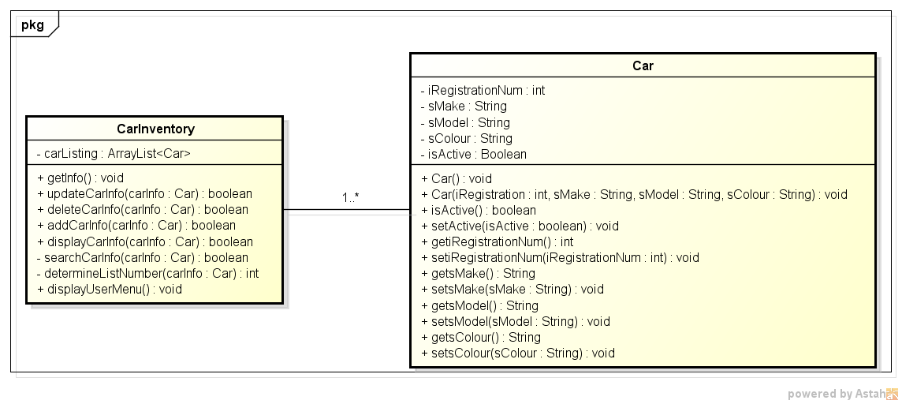
Simple Class Diagram

Slide 5
Operations Implemented (Main)
getInfo : retrieves the list of Cars and displays in a tabular form (the table formatting would need enhancements)
updateCarInfo : updates a Car object with the following user input: RegistrationNumber, Make, Model & Colour. If the RegistrationNumber does not exist in the list, no updates happen and message is displayed
deleteCarInfo : deletes a Car object with the following user input: RegistrationNumber. If the RegistrationNumber does not exist in the list, no deletion happen and message is displayed
addCarInfo : adds a new Car object into the list with the following user input: RegistrationNumber, Make, Model & Colour. If the RegistrationNumber already exists in the list, no addition happens and message is displayed
displayCarInfo : displays the Car object given the following user input: RegistrationNumber. If the RegistrationNumber does not exist in the list, message is displayed

Slide 6
Operations Implemented (Utilities)
searchCarInfo : checks if the Car object already exists in the list using the RegistrationNumber
determineListNumber : checks the sequence number of the Car object. This function supports the Deletion operation
displayUserMenu : displays the simple Car Inventory menu operations

Slide 7
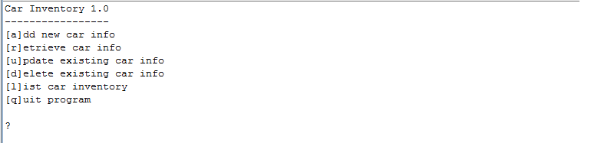
Screenshot : Opening display

Slide 8
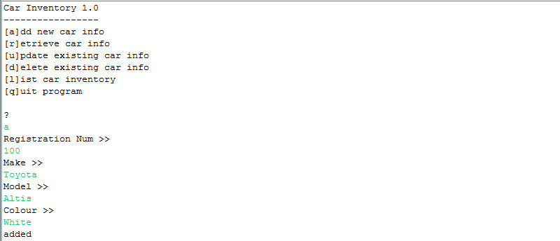
Screenshot : Add new Car Info

Slide 9
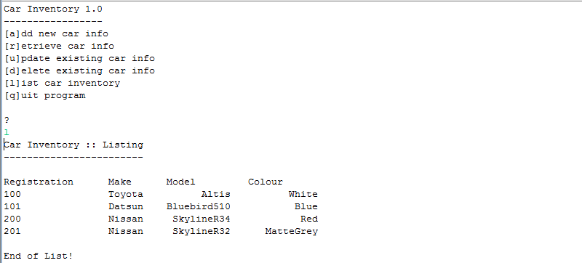
Screenshot : List Car Inventory

Slide 10
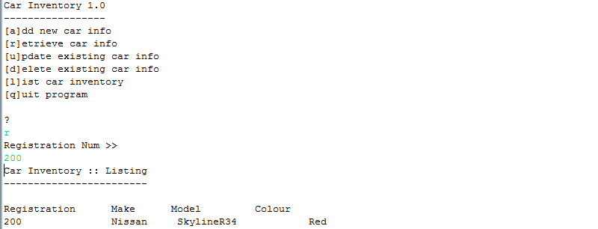
Screenshot : Display Car Info

Slide 11
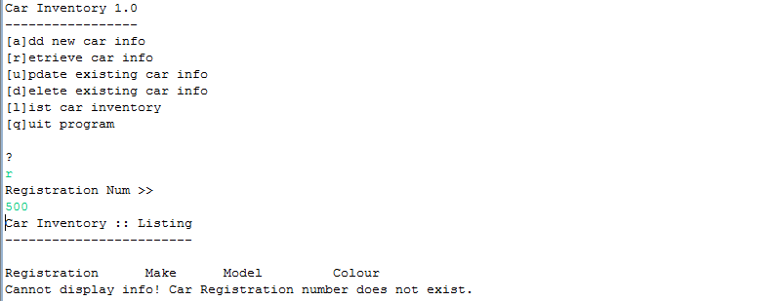
Screenshot : Invalid Display Car Info

Slide 12
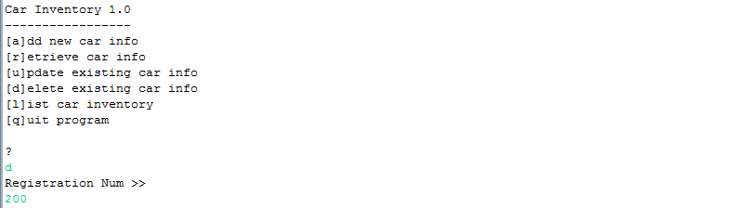
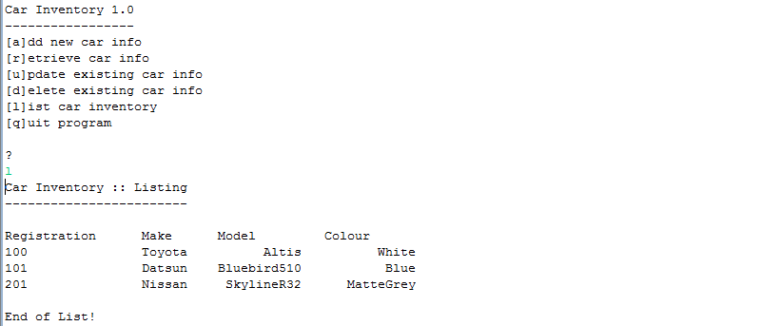
Screenshot : Delete Car Info

Slide 13
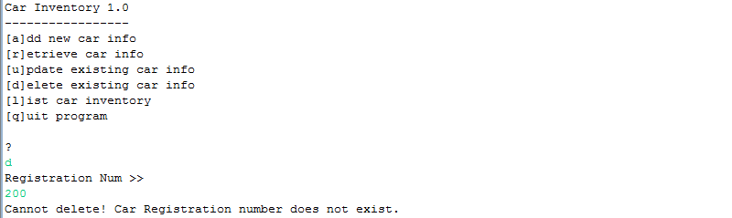
Screenshot : Invalid Delete Car Info

Slide 14
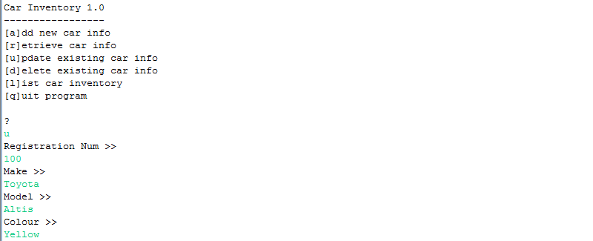
Screenshot : Update Car Info (1 of 2)

Slide 15
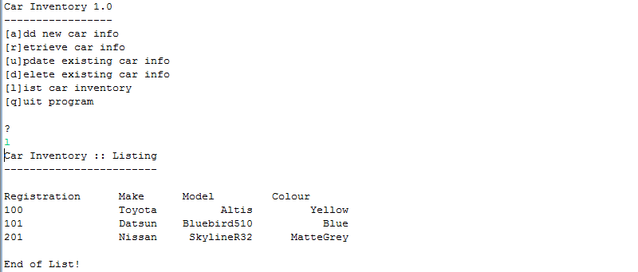
Screenshot : Update Car Info (2 of 2)

Slide 16
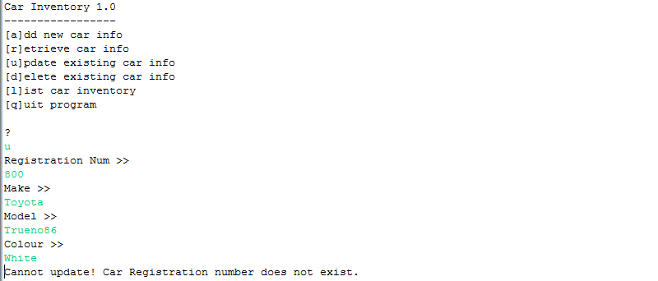
Screenshot : Invalid Update Car Info

Slide 17
Thank You
… End of Presentation

